Slide 1



Slide 2
NETFLIX
Data Exploration and Analysis

Slide 3





Group 3
Presenters Name
Madhuri
Mahek
Nitish Varma
Nitish Ram
Nitish Kumar
Umaer
Mahima
Sai

Slide 4

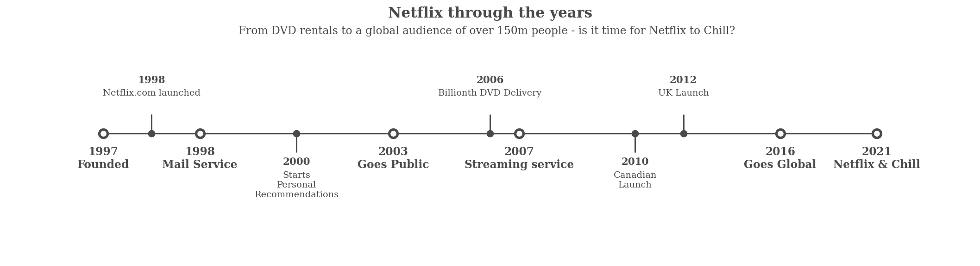
INTRODUCTION
4
Netflix is a subscription-based streaming service that offers a wide variety of TV shows, movies, documentaries, and other video content to its users. It was founded in 1997 as a DVD-by-mail rental service and has since evolved into one of the most popular streaming services worldwide. Netflix allows users to watch content on a wide range of devices, including smartphones, tablets, smart TVs, and gaming consoles, and offers personalized recommendations based on users' viewing history.
2022
In recent years, Netflix has invested heavily in producing original content, including TV shows and movies, in order to attract and retain subscribers. Netflix's success has disrupted the traditional TV and film industry and has changed the way people consume and enjoy video content.
Due to these steps taken by Netflix , A huge amount of Data is being generated

Slide 5
4
Presentation topics
1 Understanding what content is available in different countries
2 Identifying similar content by matching text- based features
3 Network analysis of Actors / Directors and find interesting insight
4 Does Netflix has more focus on TV Shows than movies in recent years.

Slide 6

Exploratory Data Analysis
4
This are the python libraries we used for Loading , cleaning , manipulating and Visualizing the data .

Slide 7
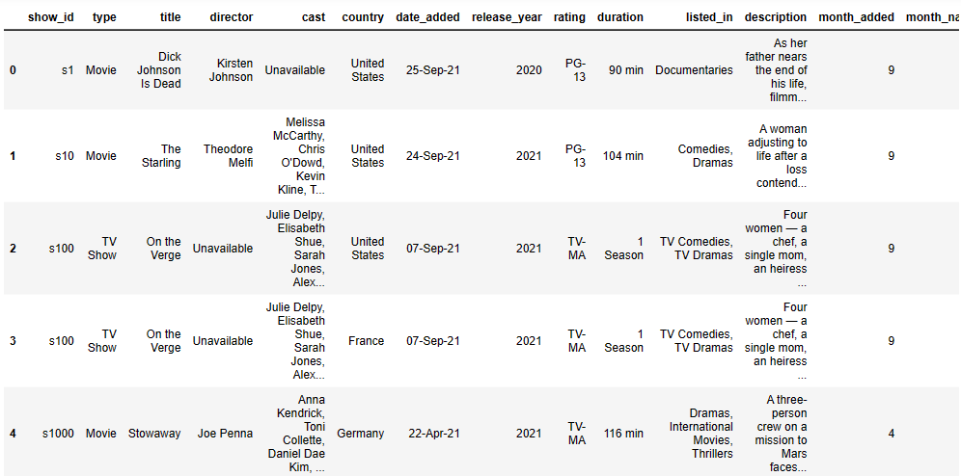
Exploratory Data Analysis
Loading The data
4
With the Help of Pandas Library, we have loaded Netflix data set In python.

Slide 8
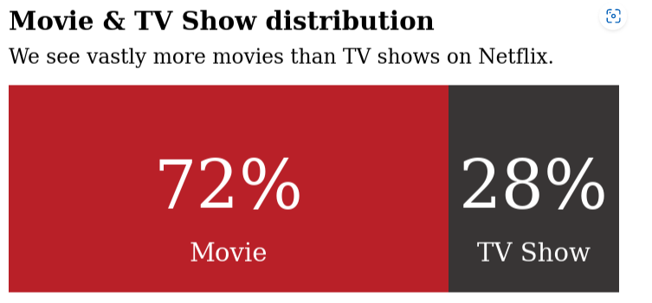
4
Distribution of content
The Chart shows that most of the content on Netflix is categories as movies with 72%
Which means that most of the viewers Like to watch movies because it helps us to gain more insights and understating in shorter period then the TV shows.

Slide 9
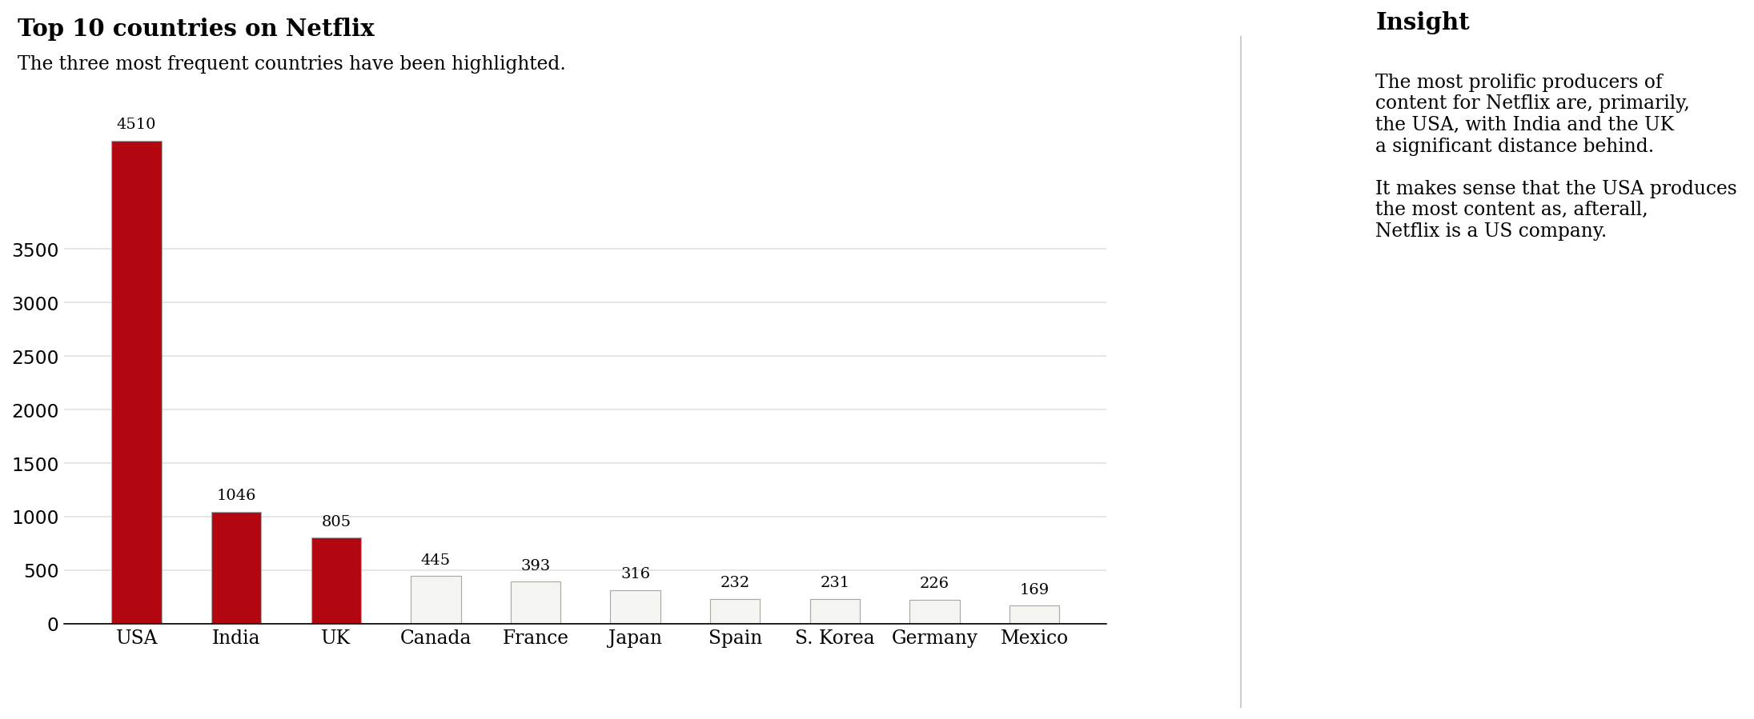
4
1 Understanding what content is available in different countries
The most prolific producers of content for Netflix are, primarily, the USA, with India and the UK a significant distance behind.
It makes sense that the USA produces the most content as, after all, Netflix is a US company.

Slide 10
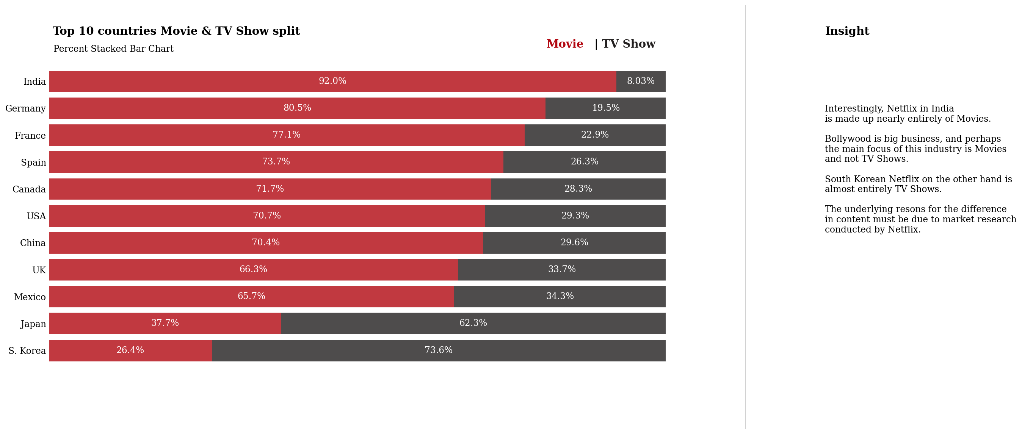
4
1 Understanding what content is available in different countries
Interestingly, Netflix in India is made up nearly entirely of Movies.
Bollywood is big business, and perhaps the focus of this industry is Movies and not TV Shows.
South Korean Netflix on the other hand is almost entirely TV Shows.
The underlying reasons for the difference in content must be due to market research conducted by Netflix

Slide 11

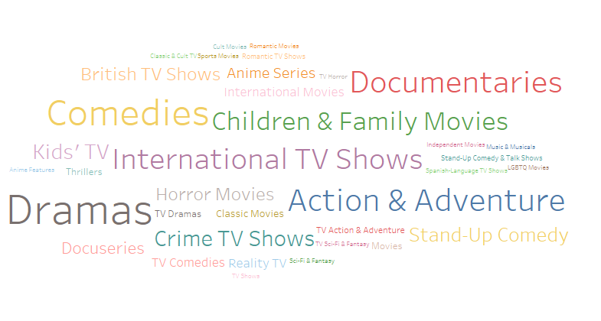
4
2 Identifying similar content by matching text-based features

Slide 12
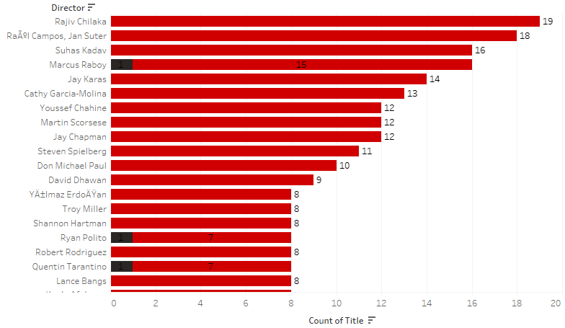
3 Network analysis of Actors / Directors
4
From the bar chart we derived that the top 5 directors on this plat form are
Rajiv Chilaka
Raul Campos, Jan Suter
Suhas Kadav
Marcus Raboy
Jay Karas

Slide 13
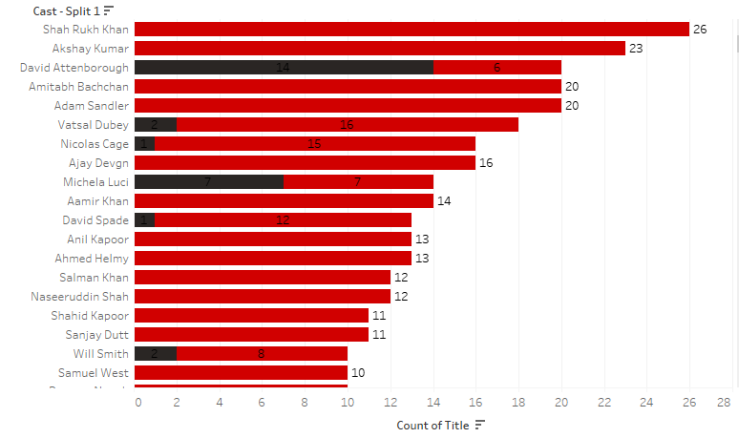
3 Network analysis of Actors / Directors
4
From the bar chart we derived that
the top 5 actors on this platform are:
Shah Rukh Khan
Akshay Kumar
David Attenborough
Amitabh Bachchan
Adam Sandler

Slide 14
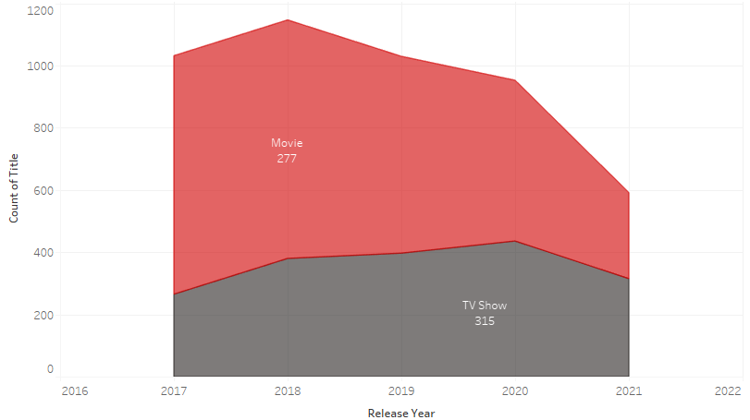
4
4 Does Netflix has more focus on
TV Shows than movies in recent
years.
There are several reasons that Netflix has chosen to focus on TV shows rather than movies. For example, its internal figures suggest that its number of movies doesn’t seem to have much of an effect on the number of people who watch Netflix, meaning that building partnerships with movie studios doesn’t provide it with the high returns that some people might have expected. In part, this could be because the people who are the most excited about movies will have seen them in the movie.

Slide 15

4
Observations:
Movies & TV Shows Distribution is; we see vastly more Movies than TV shows.
When we see by country USA dominates Netflix content followed by India and UK.
Netflix went global in 2016, as a result we see drastic increase in the content addition and was decreased rapidly during COVID 19 Pandemic.
We see in December and January Netflix is adding more new content, as it’s the best as viewers spend more time with there loved ones during Christmas and New year.
Another Observation is that International Movies are rarely in the children’s genre.
When we see USA vs INDIA, Netflix is dominated by them. Assuming that Netflix is an American company, it increased content in USA before other nations.
According to ratings, Most shows in India are targeted to teen
29

Slide 16

CONCLUSION
4
To conclude, we have constructed a relatively accurate data analysis to determine the genre of a given TV show and movie. Processing and narrowing down the features of the Netflix Dataset by identifying the top ten countries with top ten genres the audience watch and feeding this data to figure out the trend over the years, we were able to identify which actors/actresses by which directors were popular in each country. Steps such as expanding the dataset and feature set and using logistic regression might have the potential to improve upon on results in the future.
Focus on global content: Our analysis shows that users are interested in content from a wide variety of countries, and that international titles make up a significant portion of Netflix's library. To appeal to a global audience, Netflix should continue to prioritize acquiring and producing content from a diverse range of countries and cultures.

Slide 17
Thank You

